Slide 1
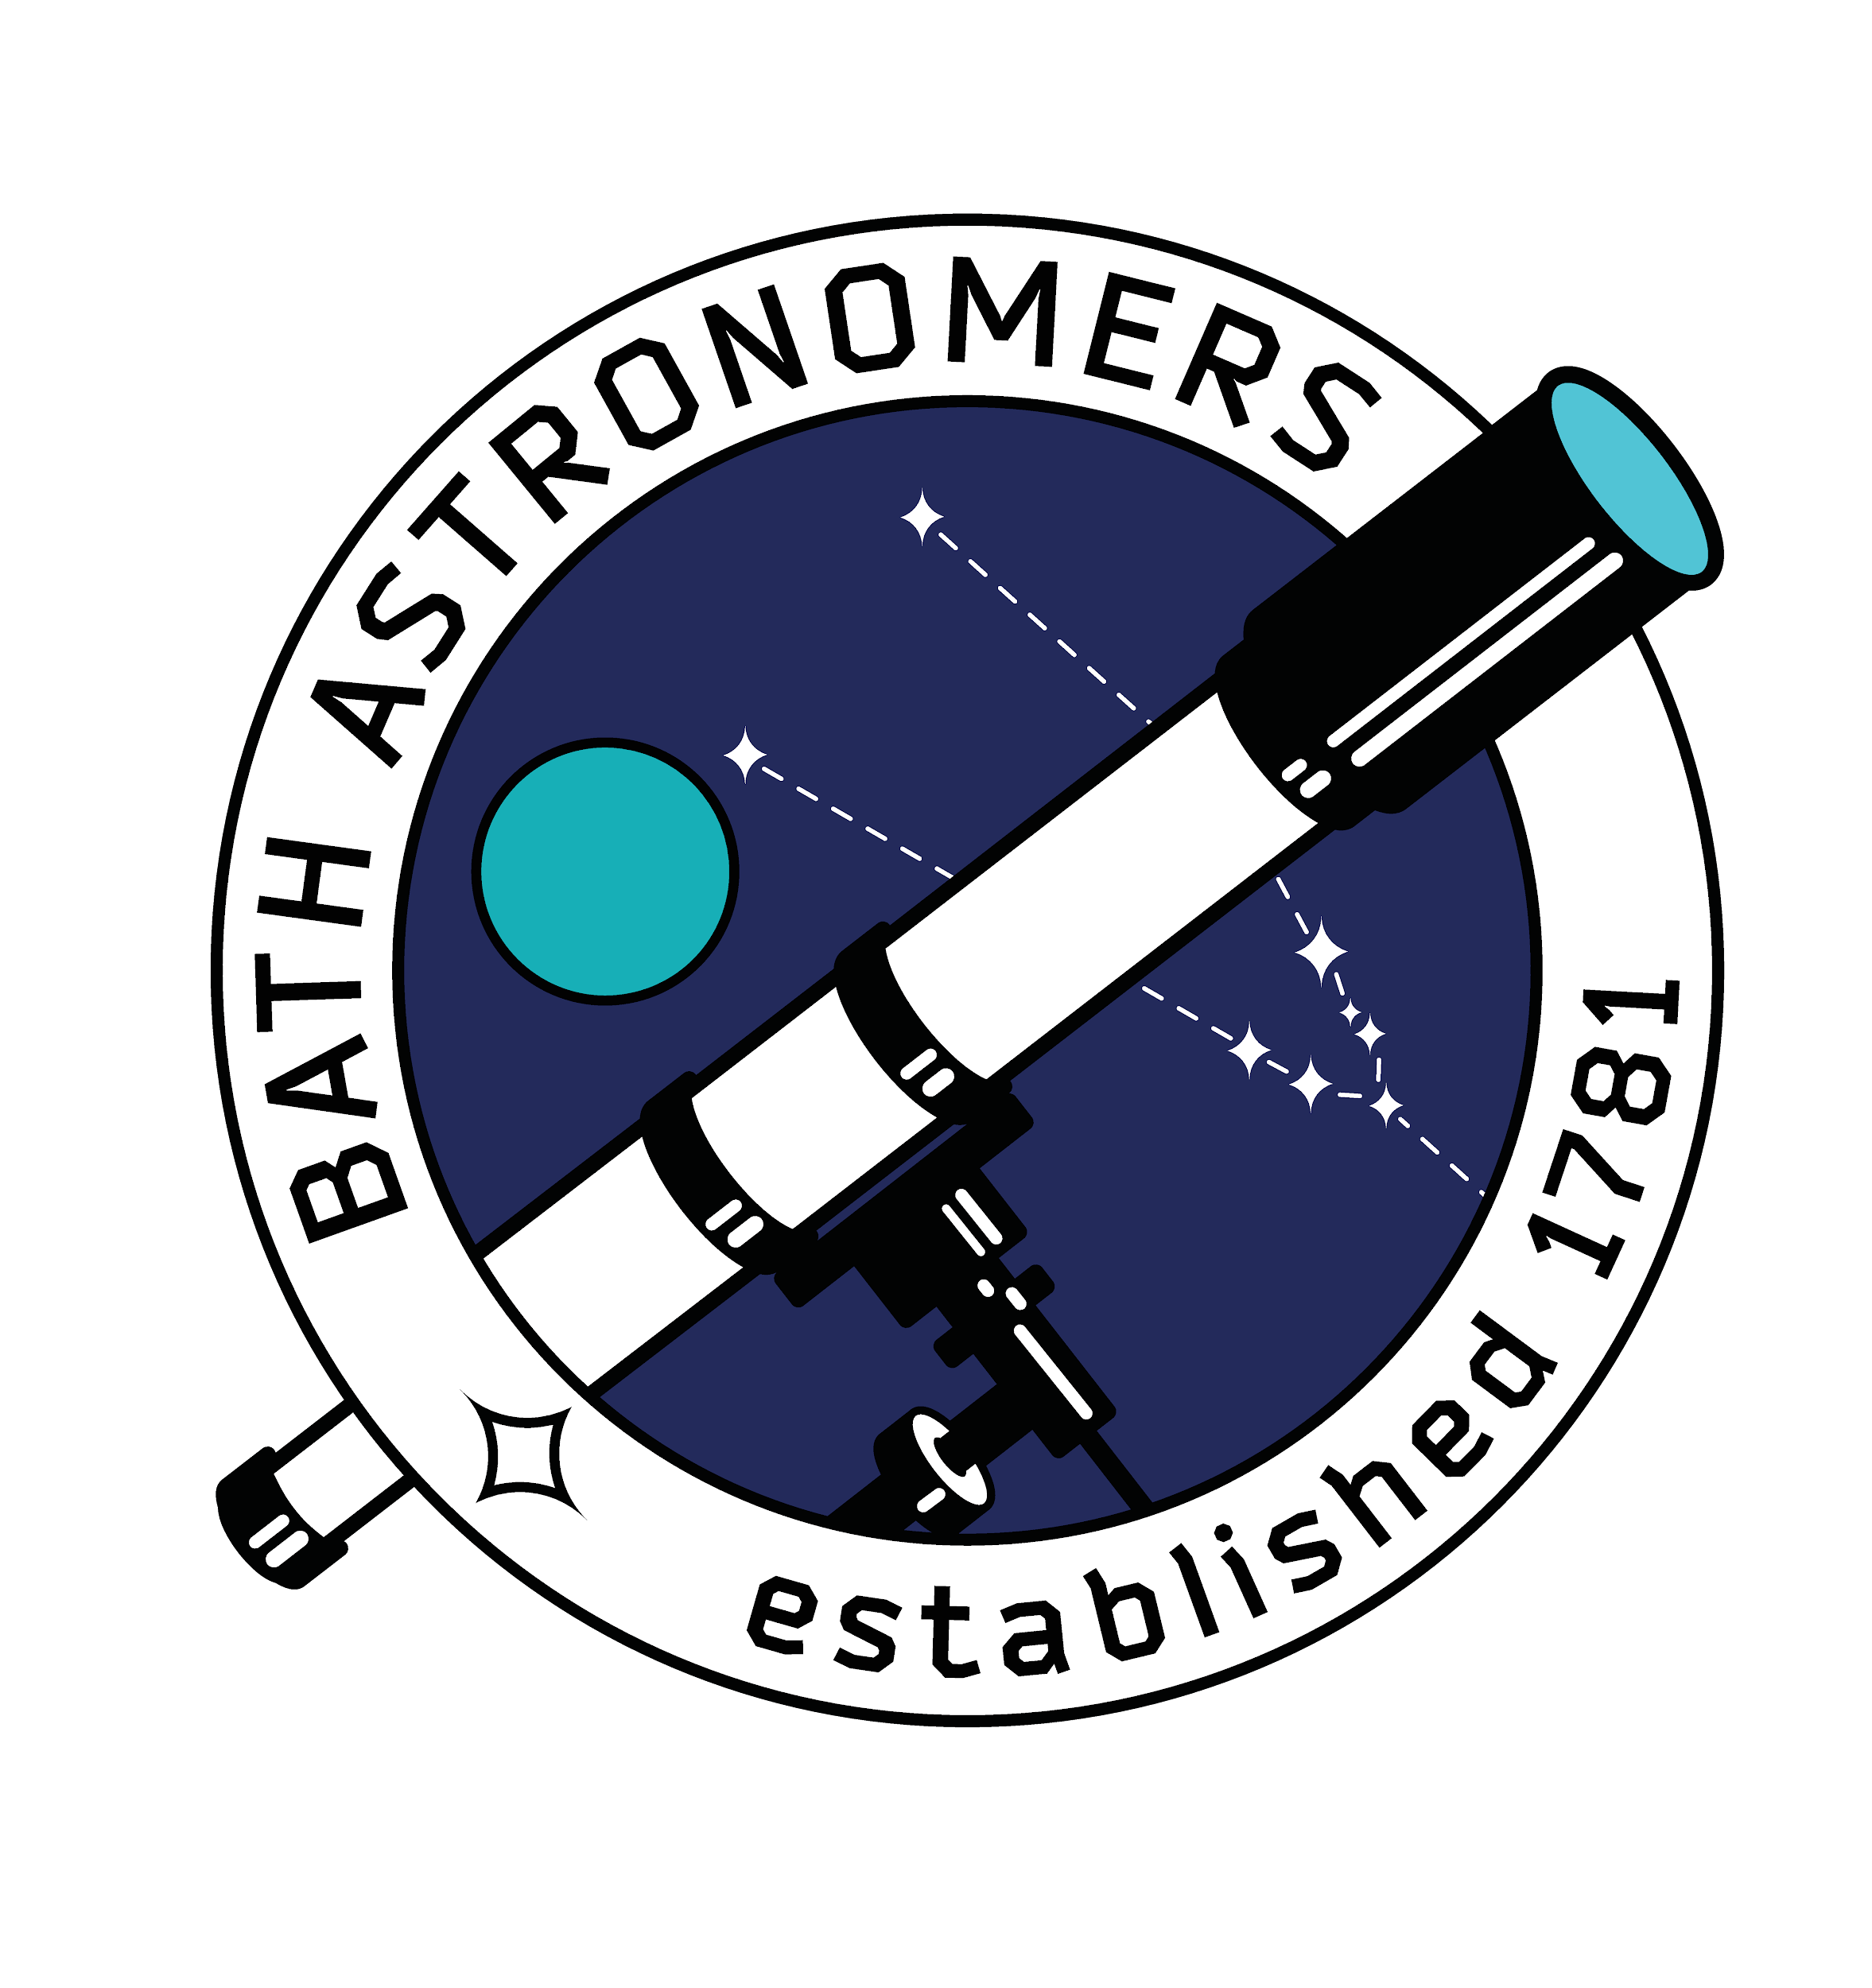
Spectroscopy
Lesson kit

Slide 2
Contents
Resource list for educators
Spectroscopy, what is it?
A brief history
Absorption and emission
Task: Make your own spectroscope
Task: Use your spectroscope
Think
The James Webb telescope
Take part - further study
Get in touch
Lesson plan

Slide 3
Resource list for educators
Without our free loan box
Our spectroscopy box printable pdf, available for free here
The spectroscopy box printed on thin card, enough for 1 between 2 or more
Old CD’s, one per spectroscopy box
Scissors, glue or sellotape
Access to sunshine
Access to different lights (incandescent bulbs, neon or plasma lights optional)
With our free loan box
Scissors, glue or sellotape
Access to sunshine
Access to different lights (incandescent bulbs, neon or plasma lights optional)
Please be mindful to return the CDs to the loan box

Slide 4
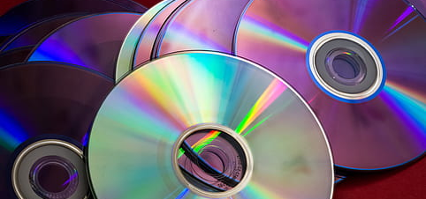
Spectroscopy
What is it?
Spectroscopy allows us to study matter from very, very far away in astronomy.
All matter will absorb, emit or reflect light in different ways.
By looking at the emitted, reflected or radiated light, you can learn about the matter it was interacting with or radiated from.
This means we can study that light, to work out what a star very, very far away might be made from, or deduce the atmosphere of an exoplanet.
A low-tech approach is to use old CDs as prisms to split the incoming light.
Please don’t stare directly at the sun.

Slide 5
A brief history
Do you think scientists make discoveries alone? Or do discoveries often occur as a continuation of work?
Isaac Newton
Developed a theory of colour by observing how white light split through a prism, ~1704.
Joseph von Fraunhofer
Developed diffraction grating, more clearly dispersing the light allowing for more accurate observation, 1814.
Robert Bunsen and Gustav Kirchoff
Studies the spectra produced by different chemicals, 1859.
William and Margaret Huggins
Deduced that stars were made of the same chemicals as found on Earth, and distinguished nebulae from stars in the 1860’s.

Slide 6
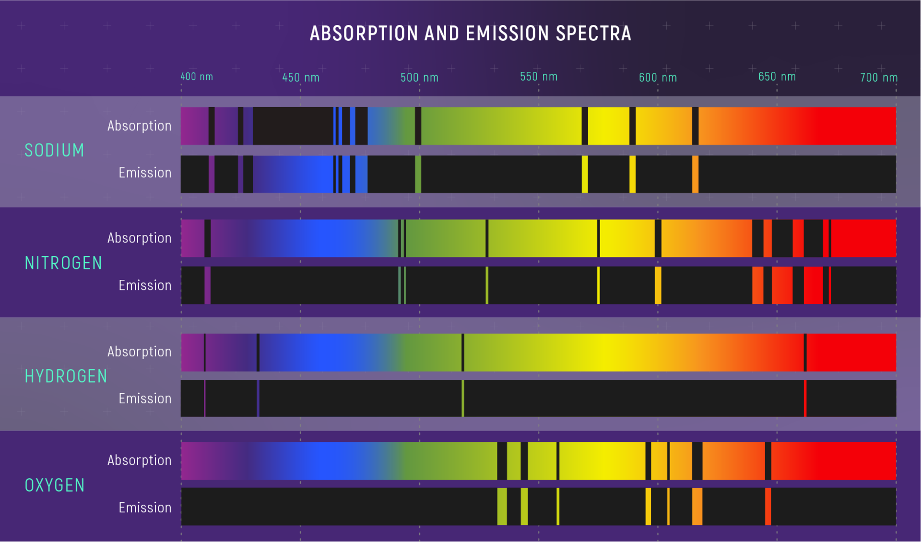
Absorption and emission
As light passes over matter, some wavelengths can be absorbed. Some matter, such as gases, can glow, which can emit light.
Different elements have different patterns of absorption and emission, which gives us a key to help spot them in space, a spectral signature!
What might our planet’s atmospheric spectral signature look like?
Our atmosphere is about 80% nitrogen and 20% oxygen!
Fraunhofer lines!
Image credit: ESA

Slide 7
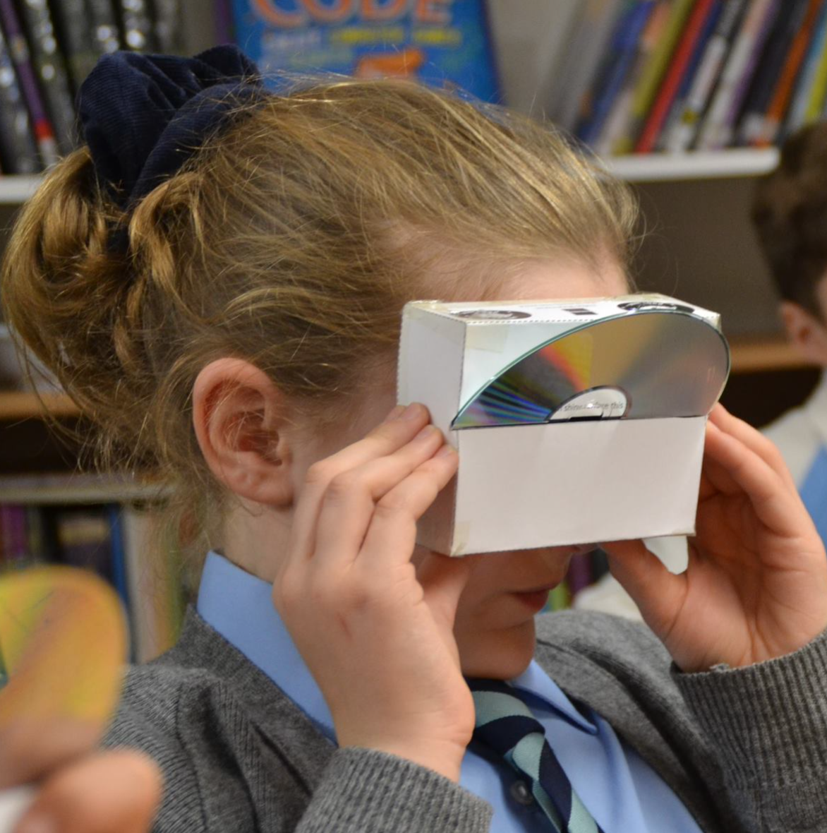
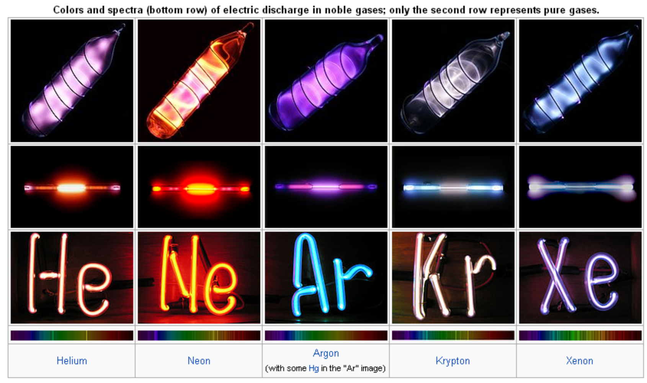
Task: Make your own spectroscope!
Use our spectroscope pdf printed on to card.
Cut out and stick the spectroscope, leaving a slit clear for the CD!
Insert a CD and take a look.
Close one eye to block unnecessary light.
Try different light sources, such as incandescent bulbs, sunshine, or even neon lights or plasma lights!
Try and spot the fraunhofer lines! (Spectral signature keys on the next slide)
Image credit: Wishford Schools
Image credit: Boundless Chemistry

Slide 8
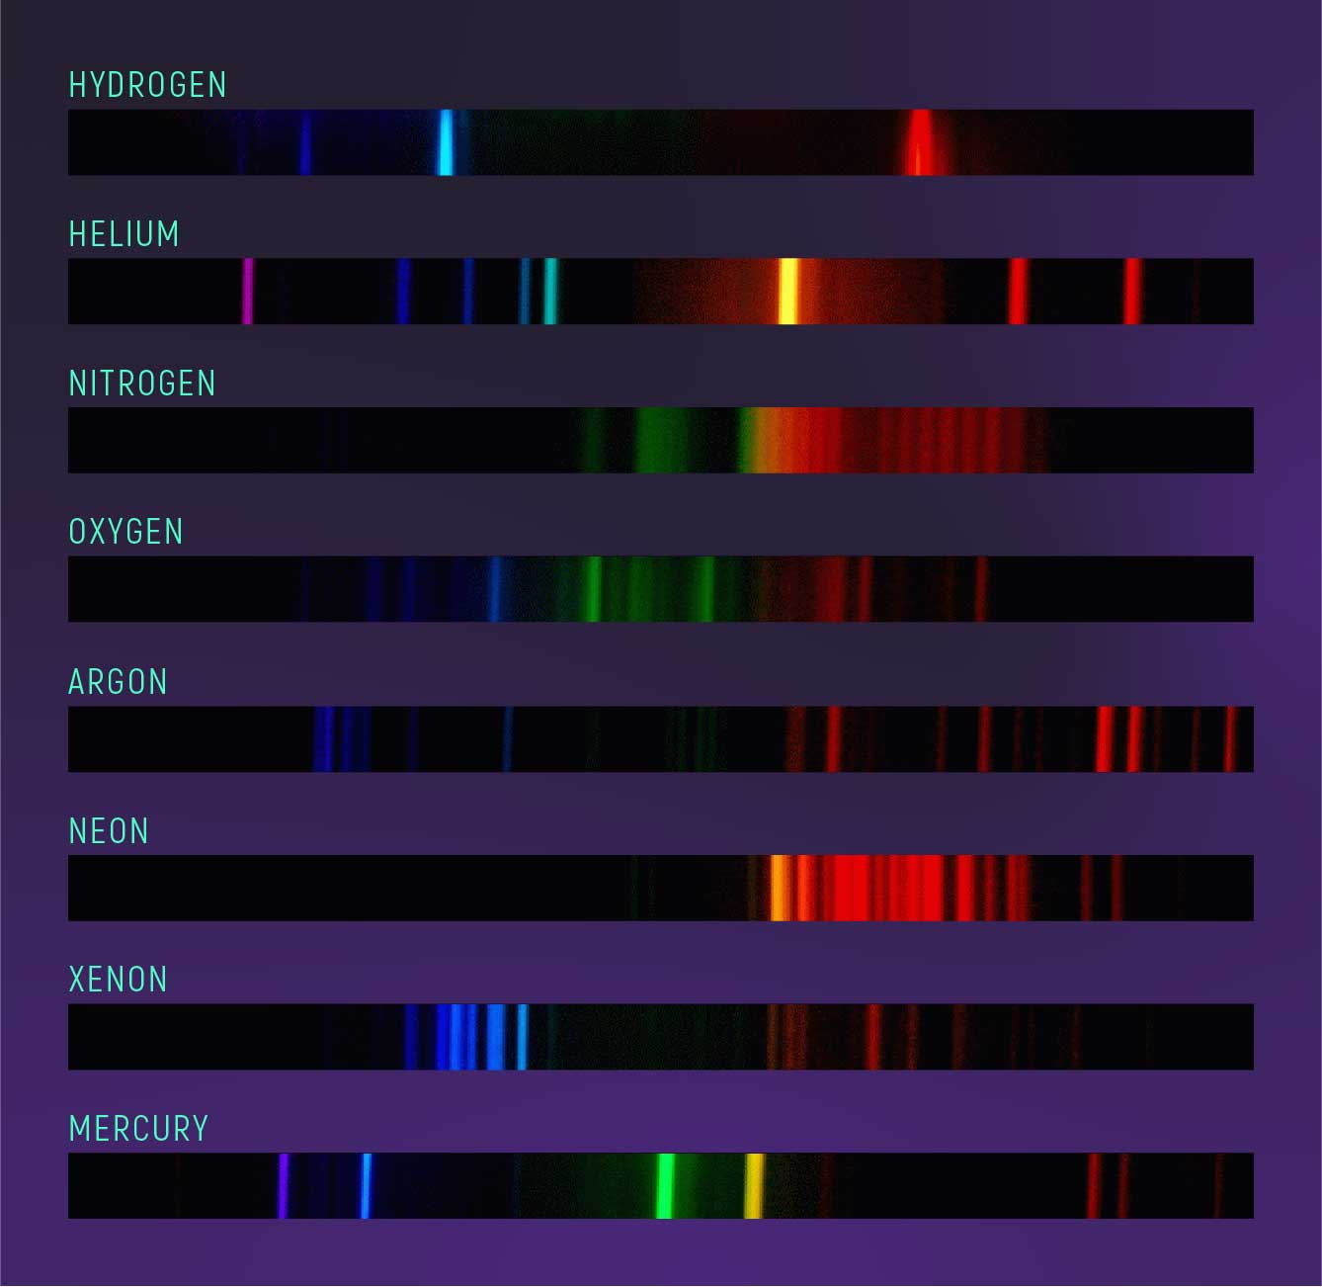
Task: Use your spectroscope!
Try different light sources, such as incandescent bulbs, sunshine, or even neon lights or plasma lights! Try and spot the fraunhofer lines.
Image credit: ESA
Image credit: M. Richmond, RIT.

Slide 9
Think: What do you now have in common with a space telescope?

Slide 10
The James Webb telescope uses spectroscopy to determine what different objects in space are made of, just like you tried to do!
Image credit: ESA

Slide 11
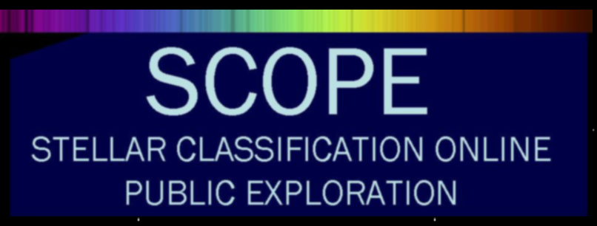
Take part - further study
Now you have learned all about spectroscopy, do you want to help real scientists classify stars?
Citizen science projects allow people like you to help sort data, and this project is all about analysing stars through spectroscopy.
http://scope.pari.edu/takepart.php
“At SCOPE, you have the opportunity to explore this topic by observing stars, comparing their features to those of the Sun, and classifying them. Many of these stars have never been classified; you can be the very first person to measure the temperature of a star! This is discovery in the purest sense of the word.” SCOPE

Slide 12
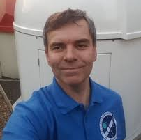
Get in touch!
If you would like further information, activity ideas or just to ask questions, please feel free to get in touch! Bath Astronomers volunteers are all keen to support an engaging and enriching space science education.
Simon Holbeche Chairperson
Bath Astronomers
Camilla Evans Lead STEM Educator
Wishford Schools
‹#›

Slide 13
Lesson plan - please copy and paste as required!
LO: To consider how spectroscopy informs us |  |  | MTP: This lesson’s placement is recommended as lesson 5 of 5. View MTP.
National Curriculum objectives | Introduction | Differentiation - support | Main Activities | Differentiation - extend | Plenary
KS3 Science Light Waves light waves travelling through a vacuum; speed of light the transmission of light through materials: absorption, diffuse scattering and specular reflection at a surface colours and the different frequencies of light, white light and prisms (qualitative only); differential colour effects in absorption and diffuse reflection. | Slides 4-6 introduce the idea behind spectroscopy and a brief history of its development. Link this learning to their experience of light, KS2 science (white light, the colours within it, and how colours are absorbed and reflected) and the idea of frequencies and wavelengths of light across the wider electromagnetic spectrum also being absorbed, reflected or emitted by different matter across space. | Pupils may need support in creating the card box for their CD. Spotting the fine Fraunhofer lines might be tricky, describe them as absences or missing light, rather than ‘black lines’. | Slides 7-8: Pupils create a spectroscopy box using card and an old CD. Pupils take time to carefully observe the colours viewed via the box. Pupils use a key to help them deduce the atmospheric makeup of the atmosphere, best completed with natural sunlight. An incandescent bulb will also work. Neon or plasma lights will show different spectral signatures, based on the often noble gases within the bulb. | Slide 11 shows an opportunity for pupils to take part in a citizen science project. Pupils would need to register, but they can analyse the spectral signatures of stars and classify them. | Slides 9-10: Link the experience of observing spectral signatures to the James Webb telescope, and how we know the makeup f distant stars, atmospheres and nebulae because of spectroscopy.
This lesson was created by Bath Astronomers, a group of amateur astronomers sharing a passion for observing the sky. Please continue to support our free space education efforts for all by giving credit where work is shared, visiting our social media sites or even becoming a member of our group.

