Slide 1
Using a Telescope
Lesson Kit by Bath Astronomers

Slide 2
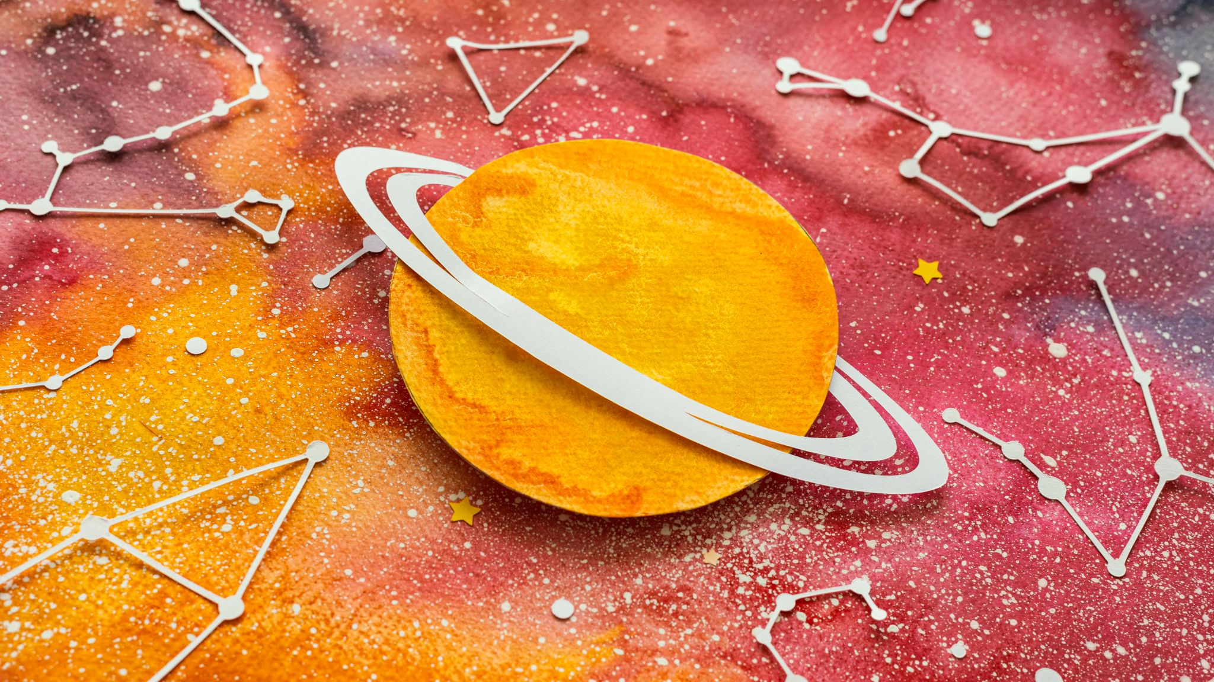
Contents
Resource list for Educators
What is a telescope?
Who created it?
Get to know the telescope
Set it up together (4 slides)
Using the controller - day and night
Safety warning
Practise finding a target in the day
Review
Next steps: Plan a twilight observation
Get in touch
Lesson Plan

Slide 3
Resource list for Educators
With our free loan box:
Without our free loan box:
A clear space in a classroom to assemble the telescope
A space in the playground where you can aim at targets 20 metres away, without risk of viewing the sun.
We recommend that you have completed Lesson 1: Navigating the Night Sky and/or 2. Using Binoculars before completing this lesson.
Access to a telescope
A clear space in a classroom to assemble a donated telescope
A space in the playground where you can aim at targets approximately 20 metres away, without risk of viewing the sun. Your telescope may have a different lens to the loan box, which may affect magnification.
We recommend that you have completed Lesson 1: Navigating the Night Sky and/or 2. Using Binoculars before completing this lesson.

Slide 4
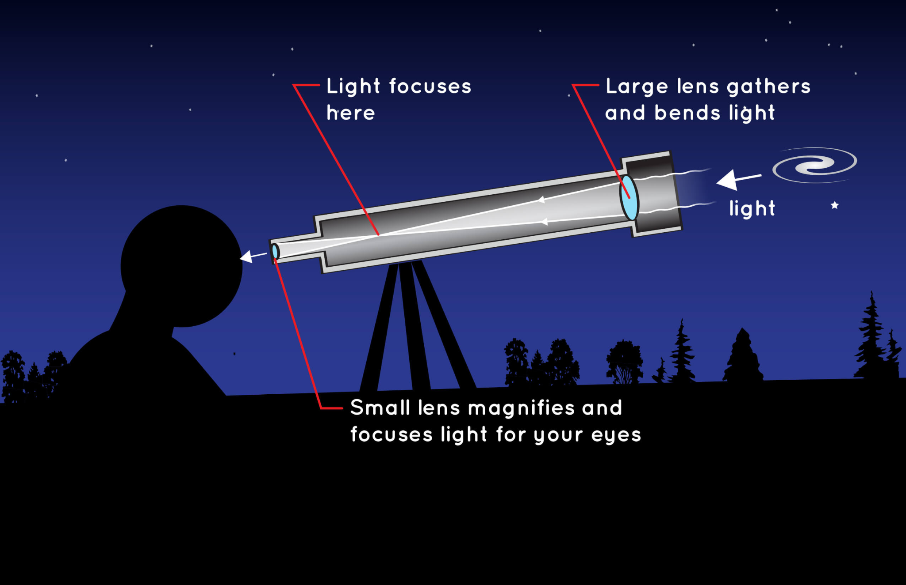
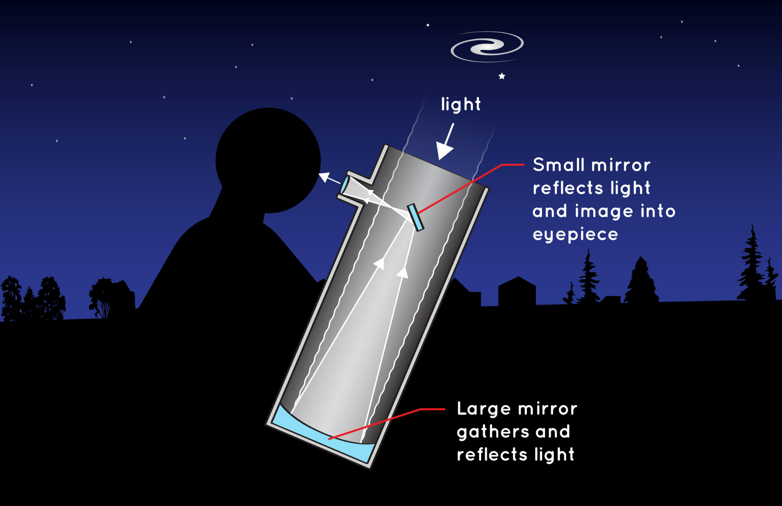
What is a telescope?
A telescope focuses light. Light from space can be blurred, scattered and spread, and a telescope aims to collect as much of that light as it can, and focus it into a small sharp image.
Early telescopes just used lenses (think of sailors at sea!) which we call a refracting telescope, whilst modern telescopes use curved mirrors which are much lighter, called reflecting telescopes.
Image Credit: NASA.gov

Slide 5
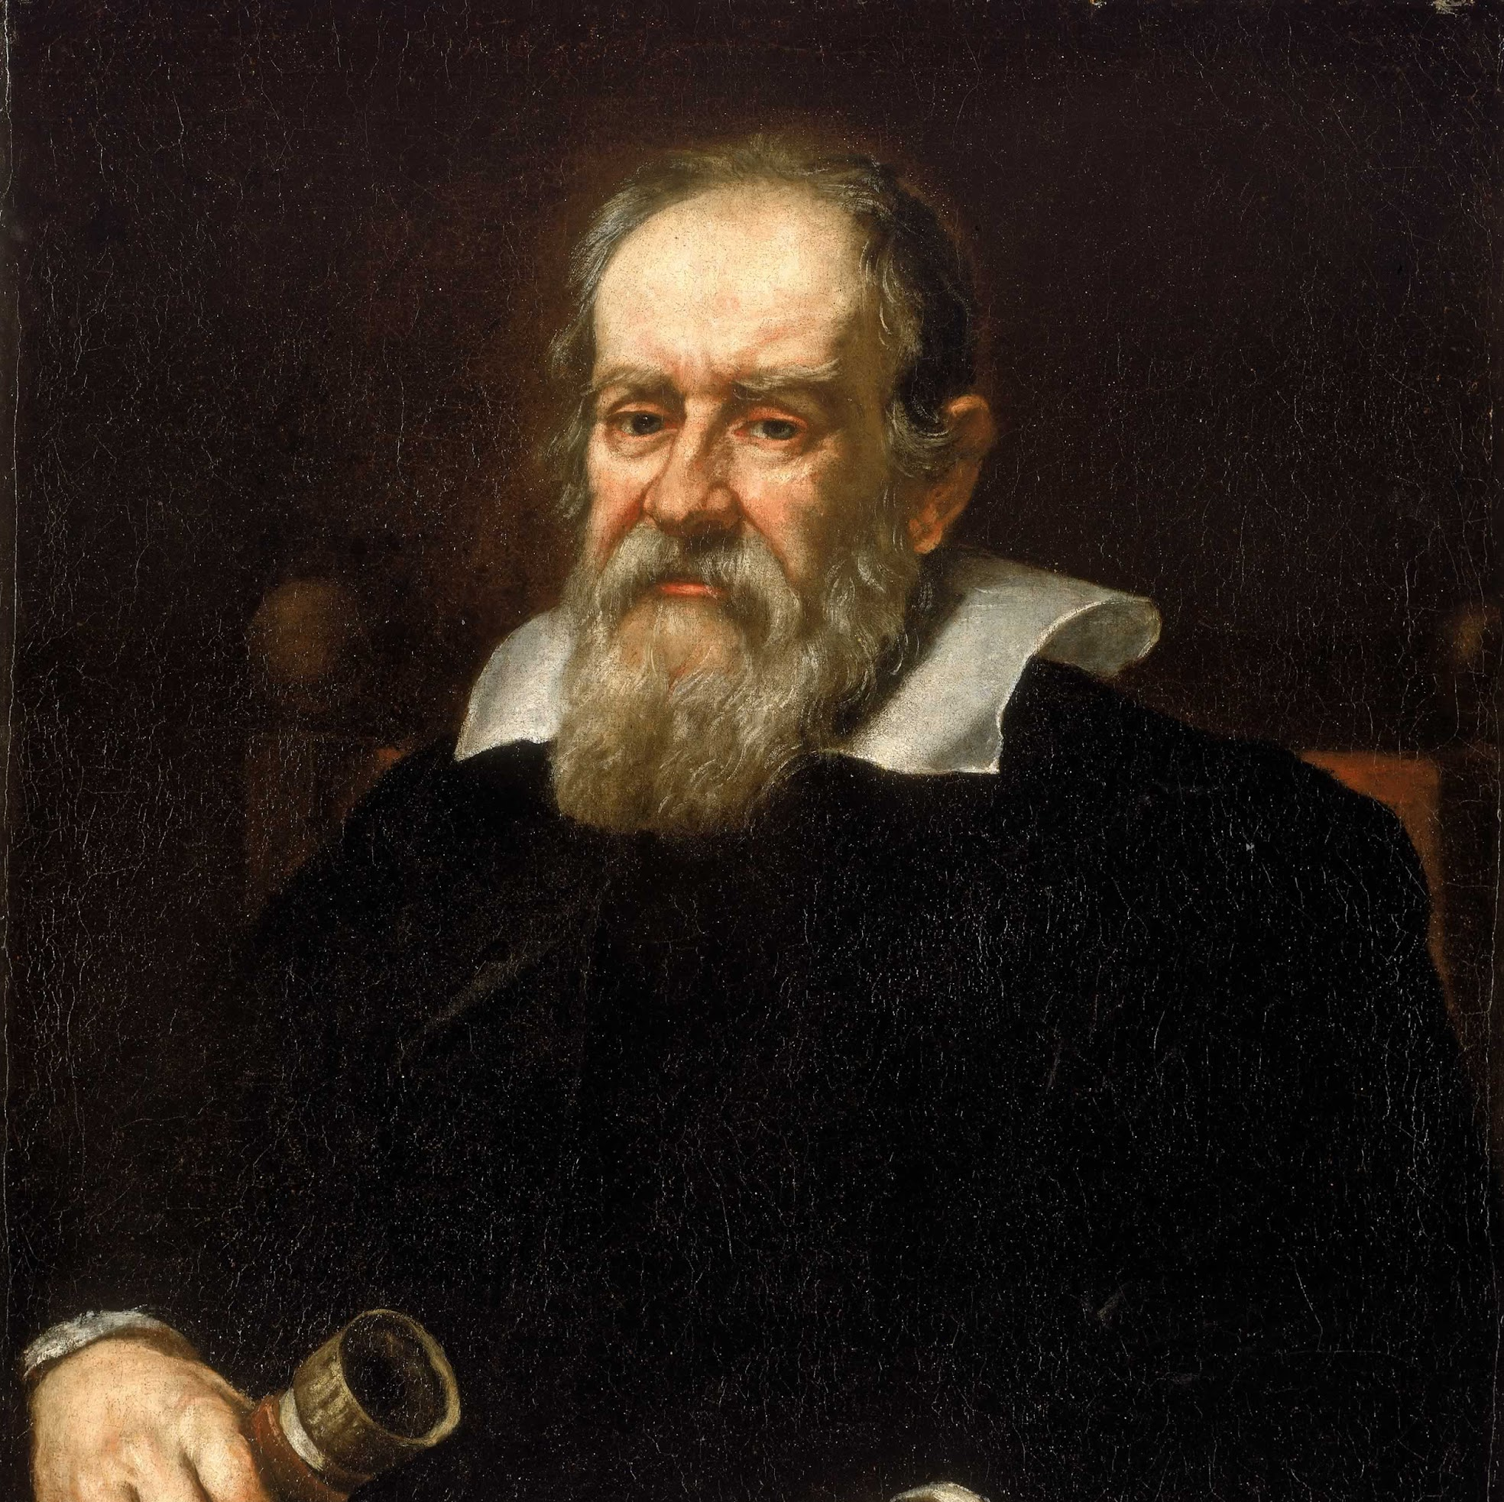
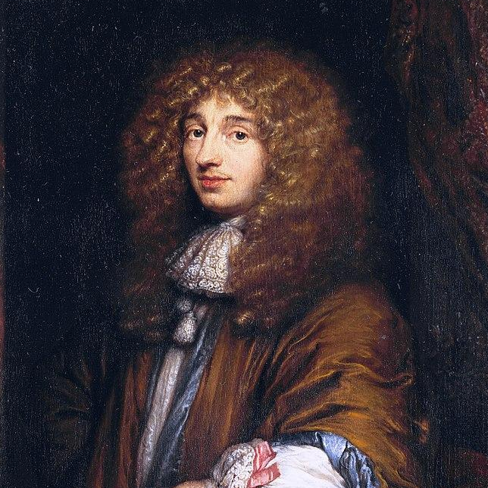
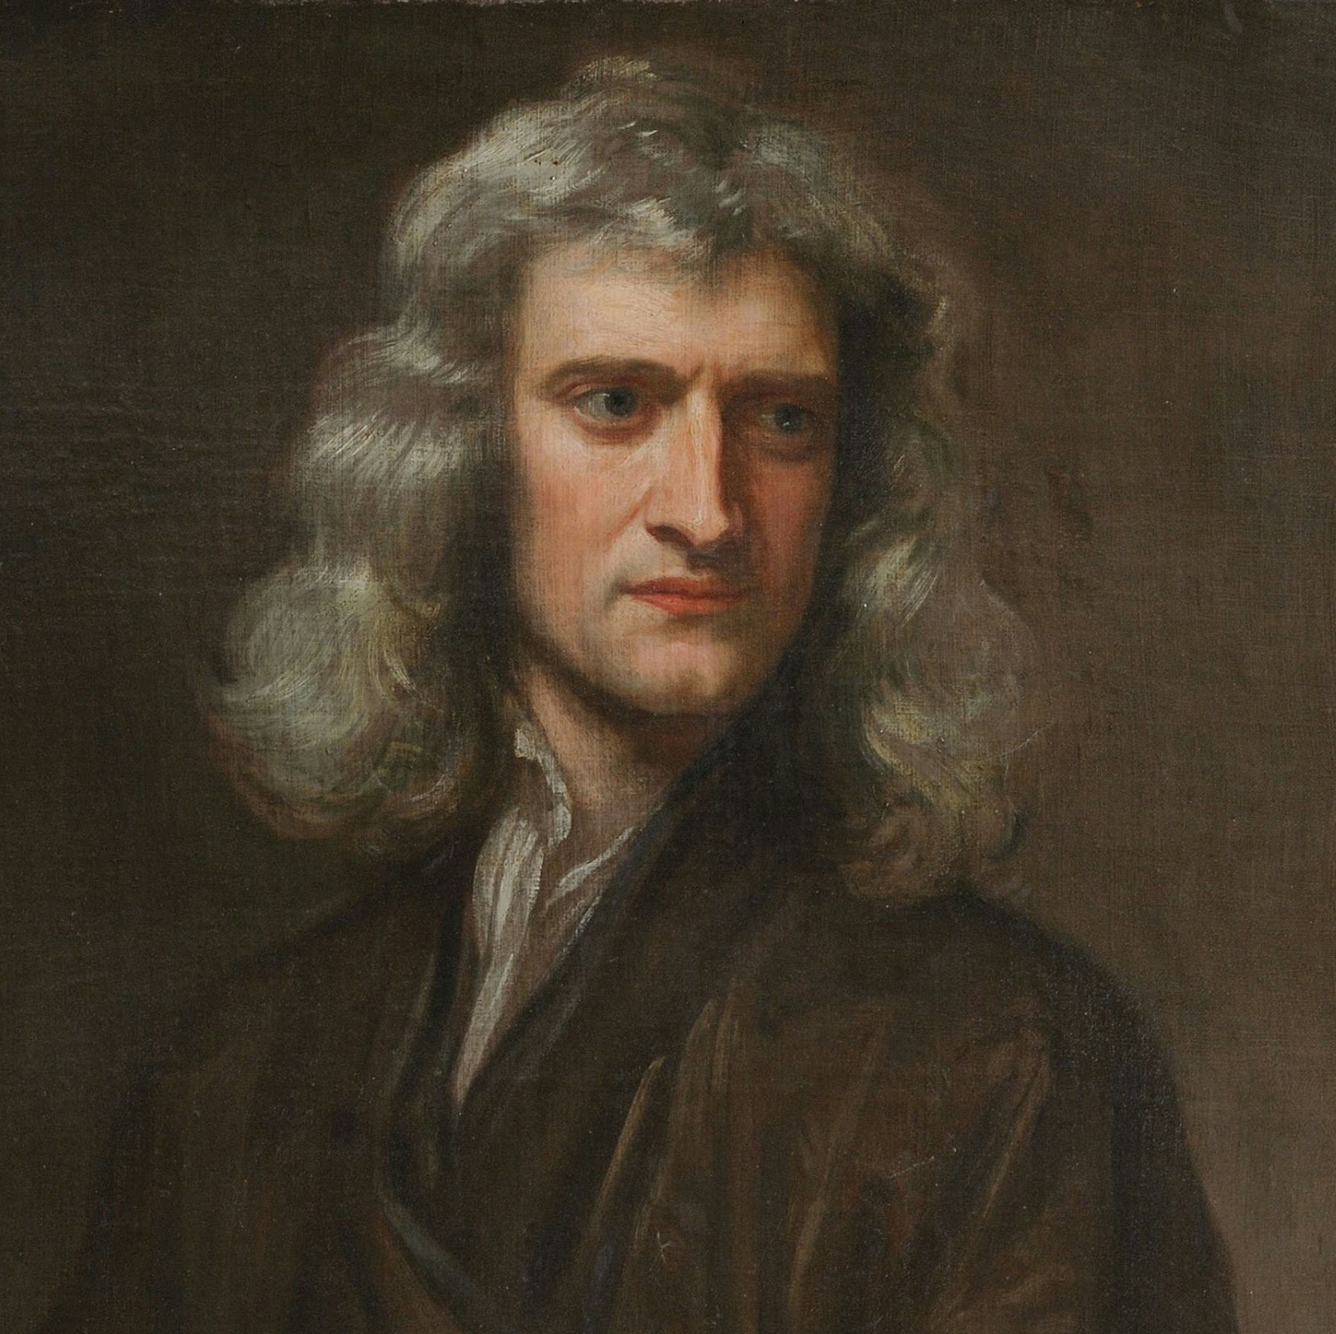
Hans Lippershay
Galileo Galilei
Johannes Kepler
Christiaan Huygens
Who created the telescope?
Isaac Newton
An eyeglass maker, patented the earliest known telescope design in 1608.
Improved on the design and applied it to astronomy.
Adjusted the lens types so that both were convex lenses.
Used Kepler’s design but created a compound eyepiece.
Built the first reflector telescope in 1668.

Slide 6
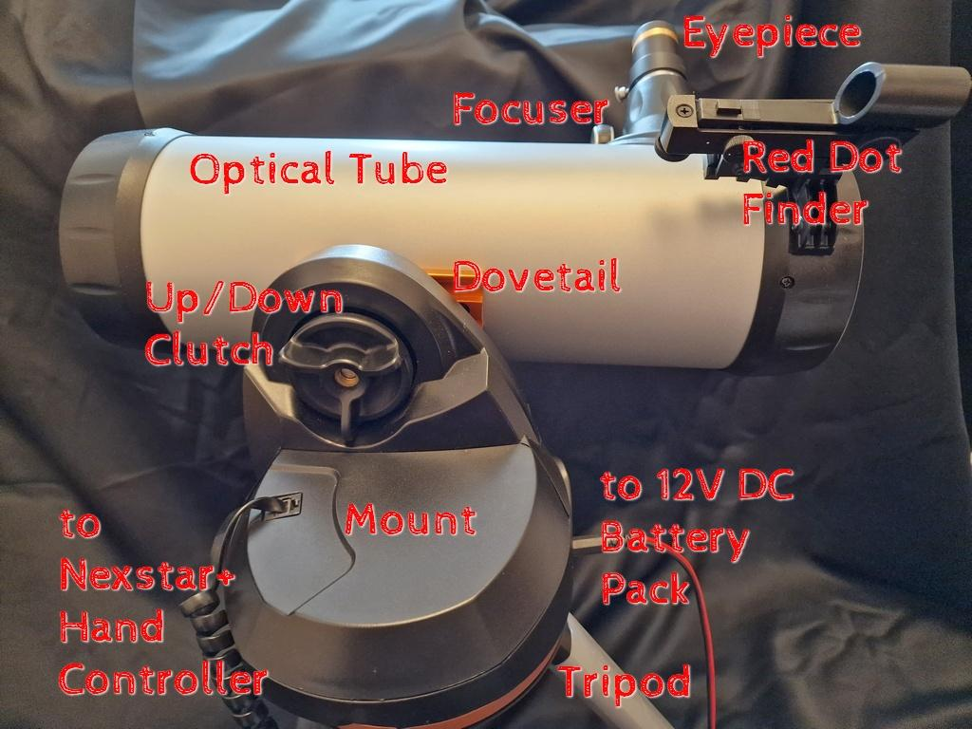
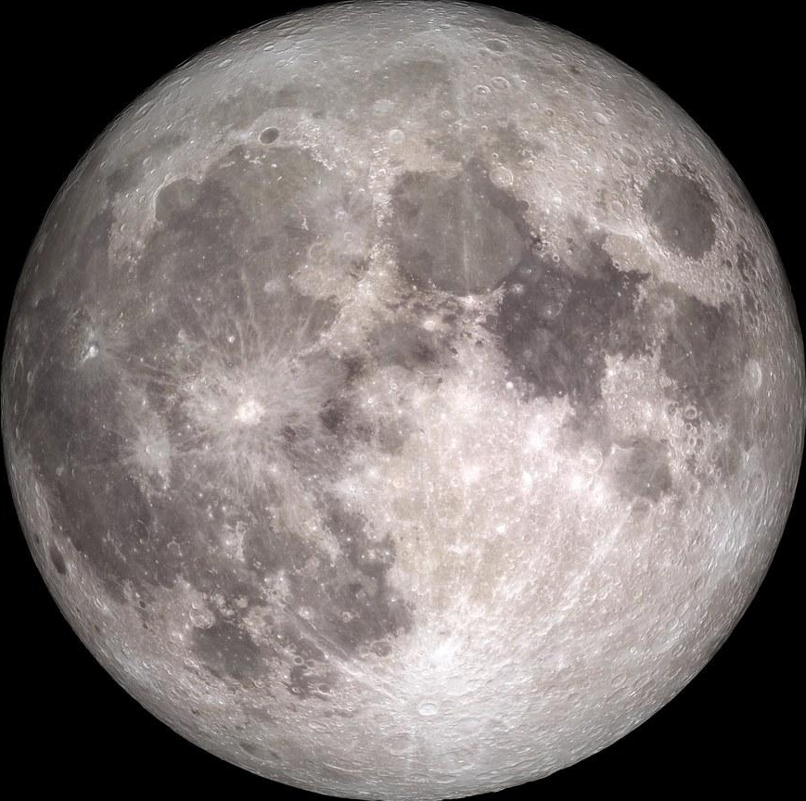
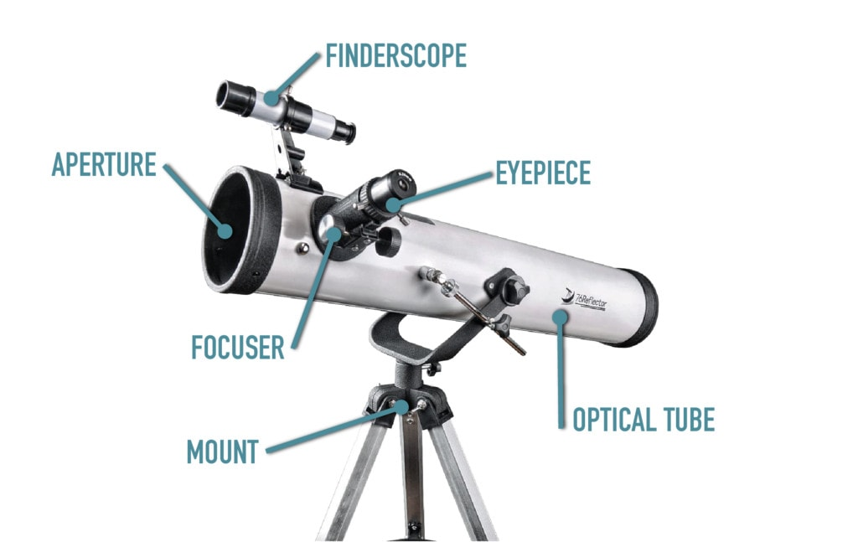
Get to know the telescope.
First, a warm up - what are these items, and where would they go?
Finderscope, optical tube, mount, eyepiece, focuser, aperture
This is the Bath Astronomers loan telescope.
What is different? What is the same?
Clear a space to begin building it as a class!
Click to reveal the answers!
Image Credit: Optics Mag
Notes:
Differences:
The finderscope is called a red dot finder.
The mount is motorised, and will move according to the hand controller.
The mount goes between the scope and the tripod.
The up/down clutch slots in to the dove tail. This makes the optical tube stay in place as the mount moves it around and up/down.

Slide 7
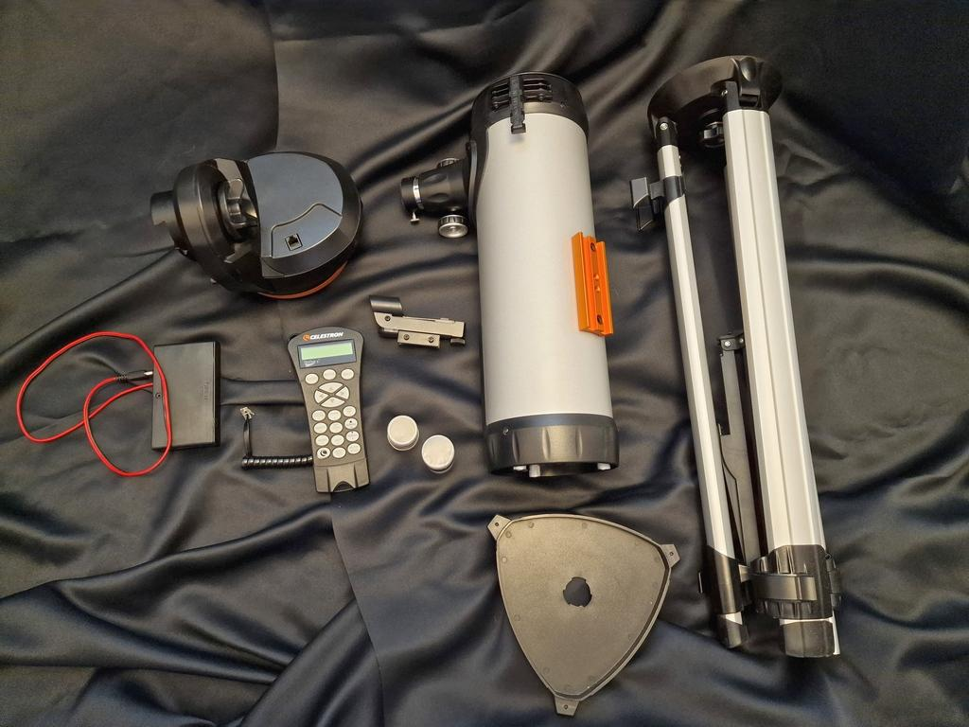
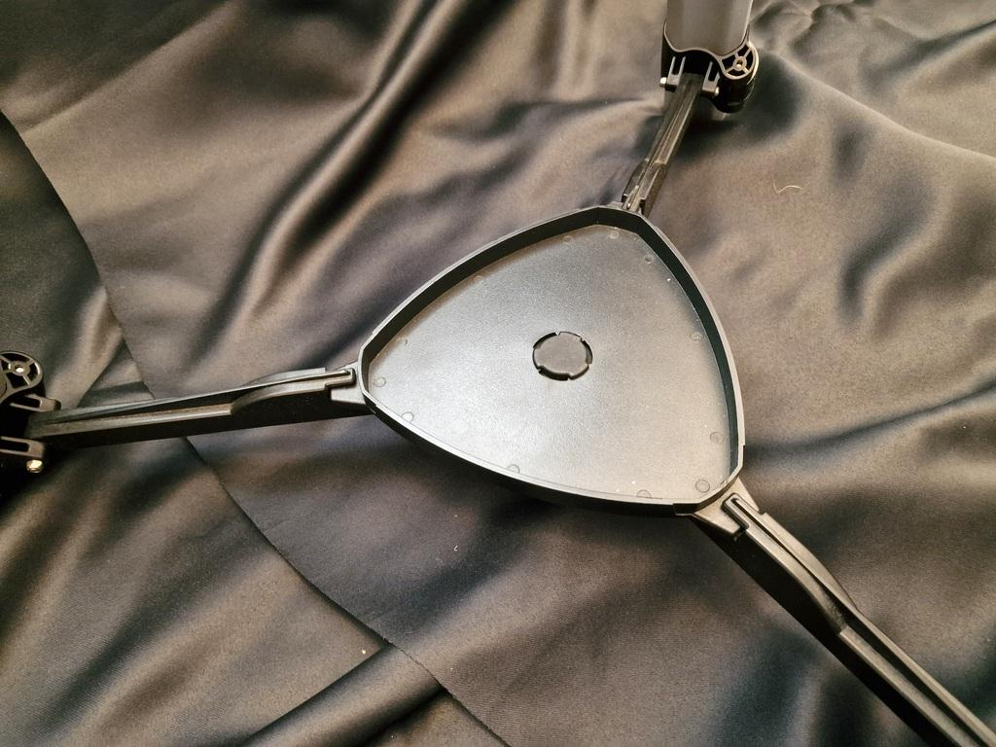
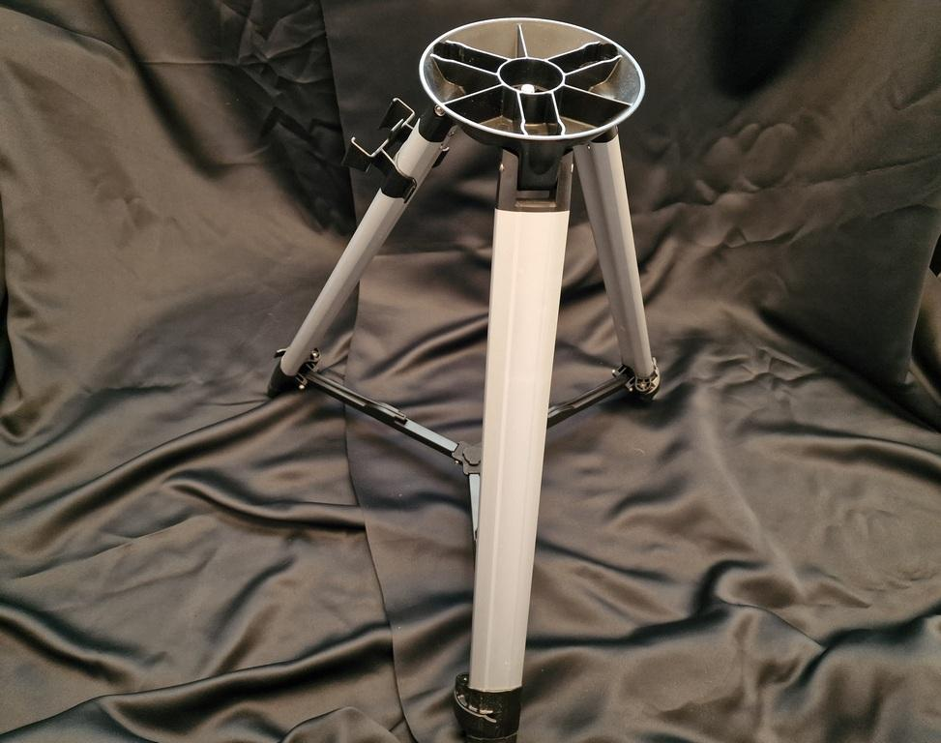
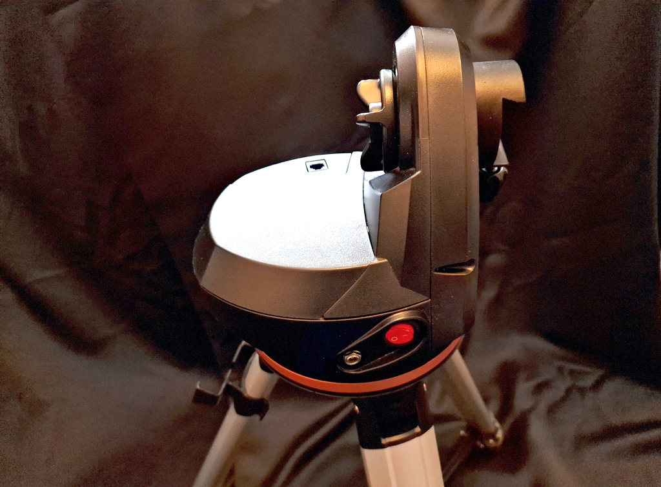
Set it up together!
Arrange the items.
Set up the telescope together step by step.
While each telescope is unique, there are common steps to setting them up..
Place handy accessory tray in bottom centre of tripod - twist to lock in place,
Erect the tripod.
Place mount on tripod.
Notes:
Place the accessory tray into the centre bottom of the tripod and twist to lock in position - it can hold all the little bits and bobs safely with the scope! Please do use it to old eyepieces and lens caps.

Slide 8
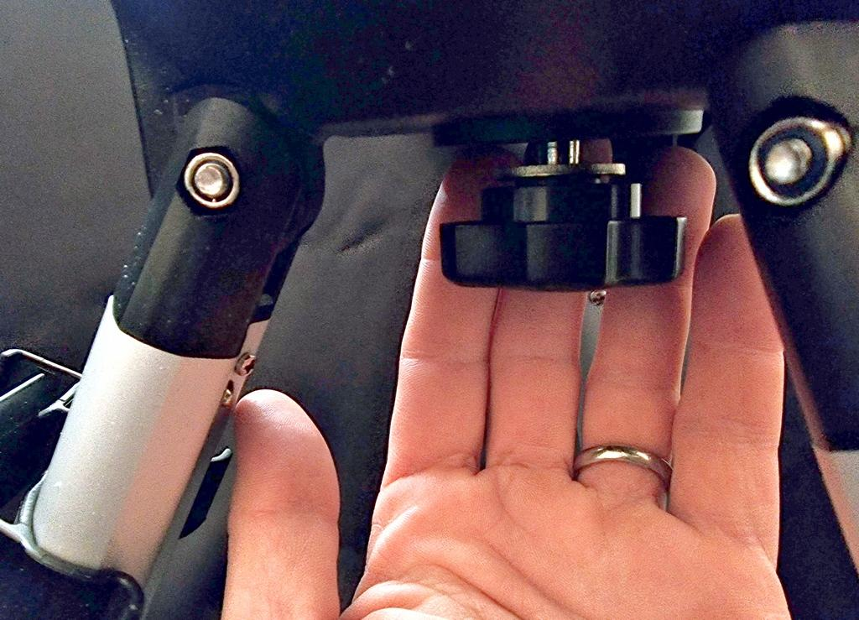
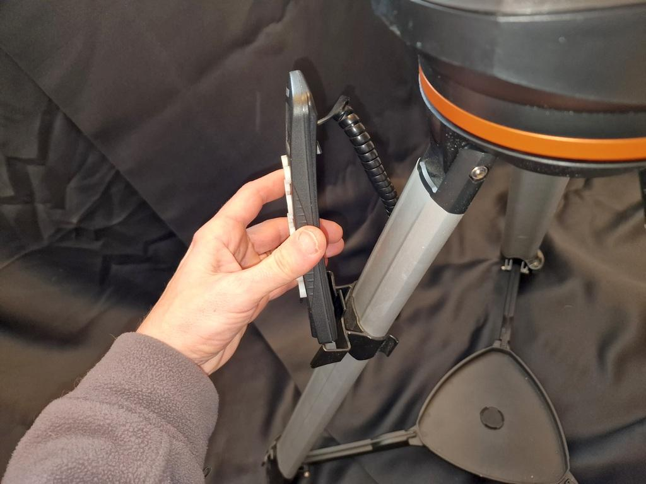
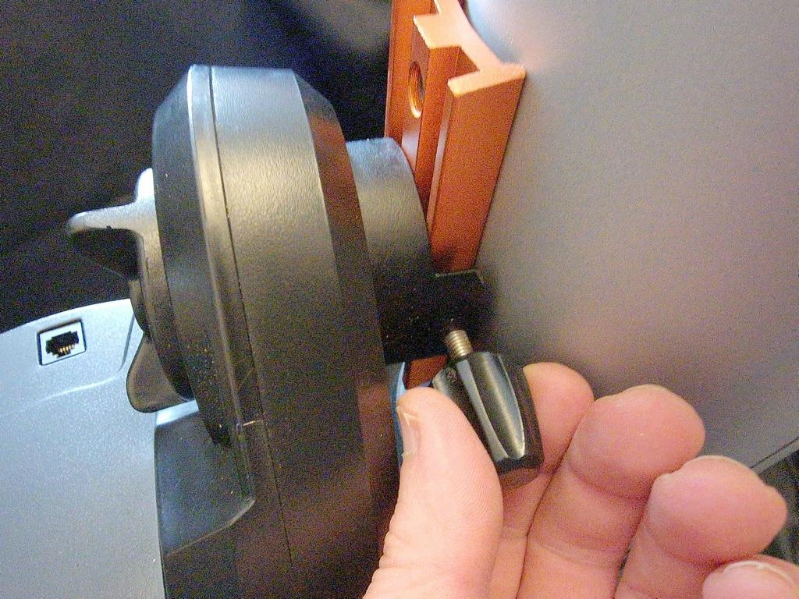
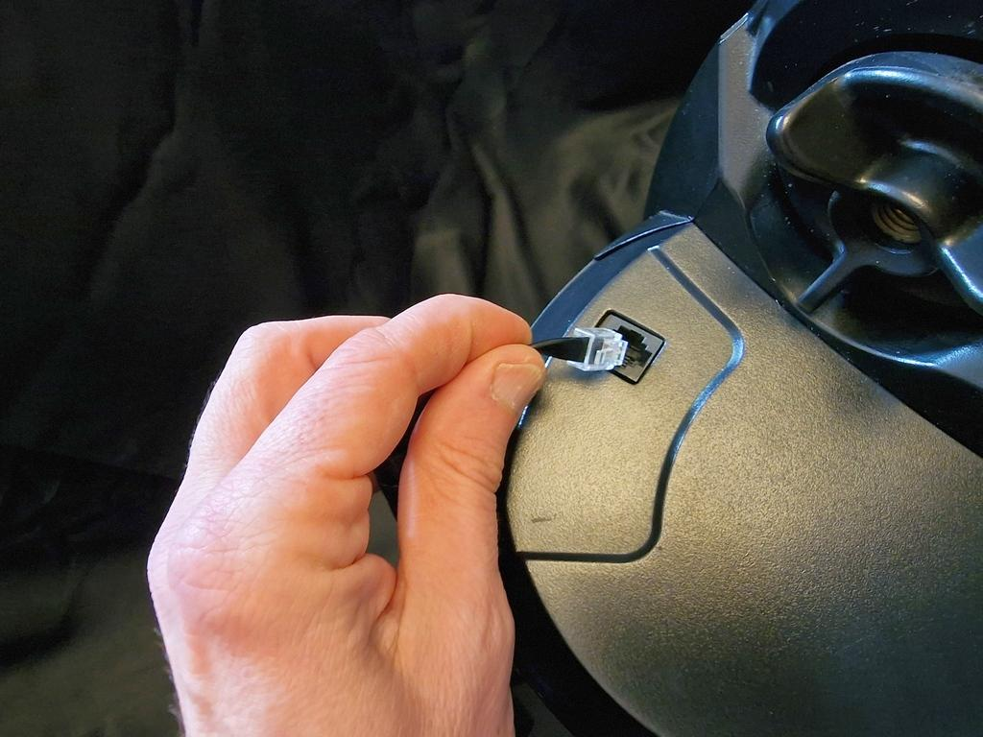
Screw mount to tripod - screw is underneath
Place hand controller in holster on tripod leg.
Slide optical tube onto mount, 50% along the orange dovetail. Screw in to finger tight.
Plug hand controller into mount.

Slide 9
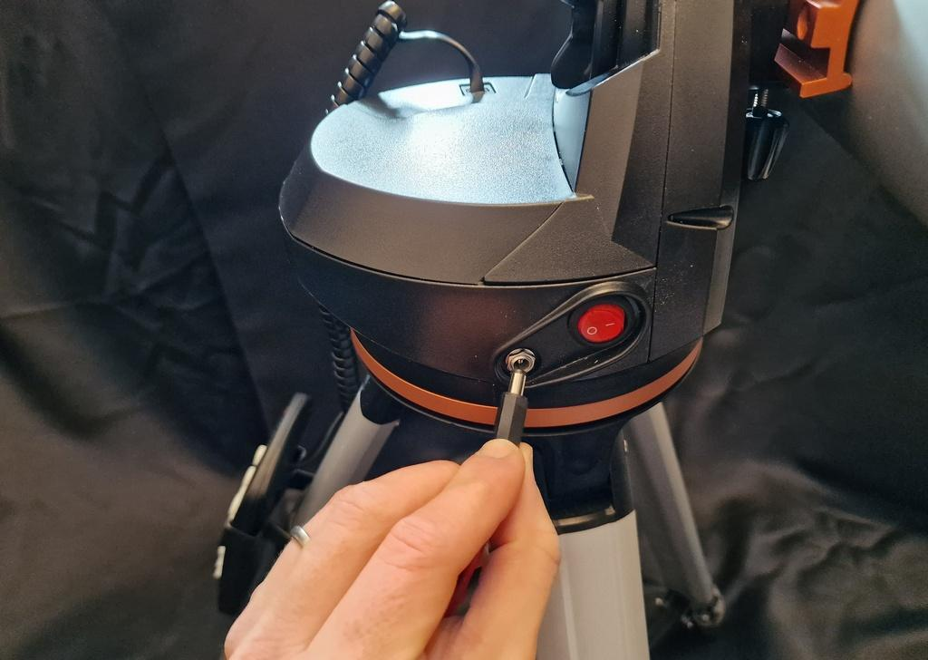
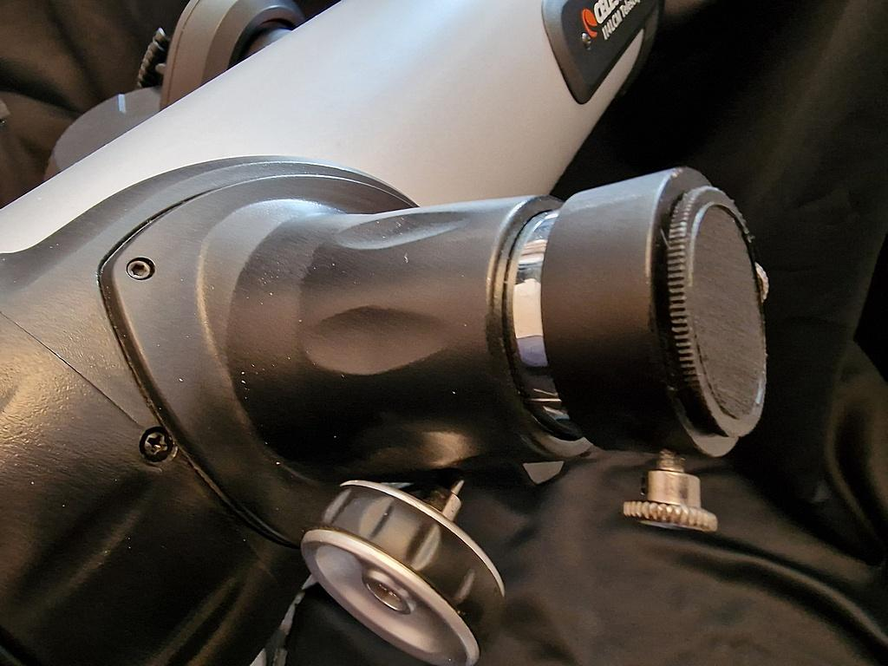
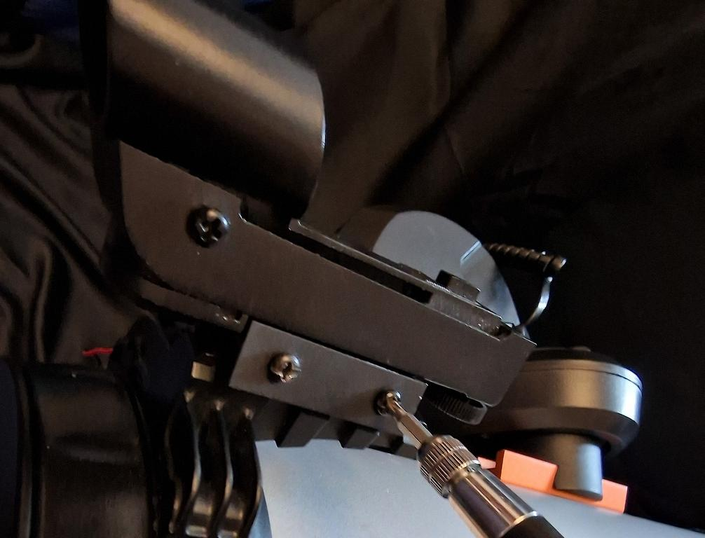
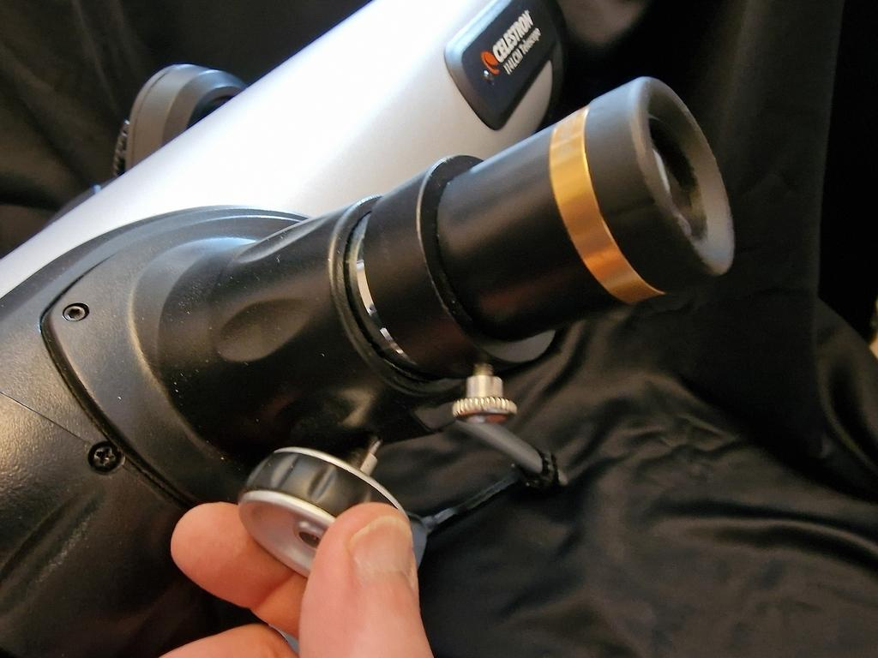
Pop power cable into mount.
Remove the focuser cap from the tube (the plastic insert, leave the screws as they are)
Insert the 23mm eyepiece and secure finger tight with the screws. (The gold band will have 23mm inscribed on it).
Add the finderscope to the front of the telescope.
This focus wheel extends/retracts the eye piece, changing the view between sharp and blurry.

Slide 10
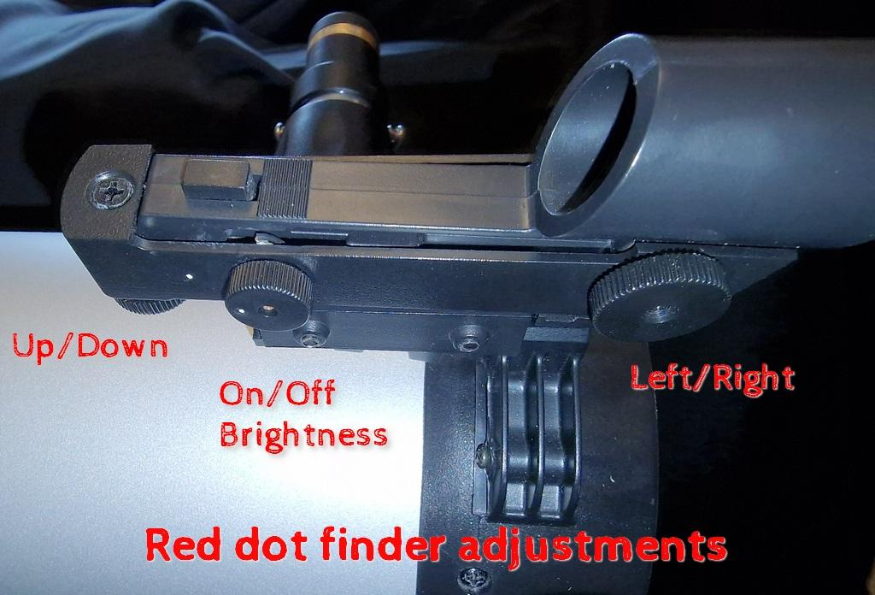
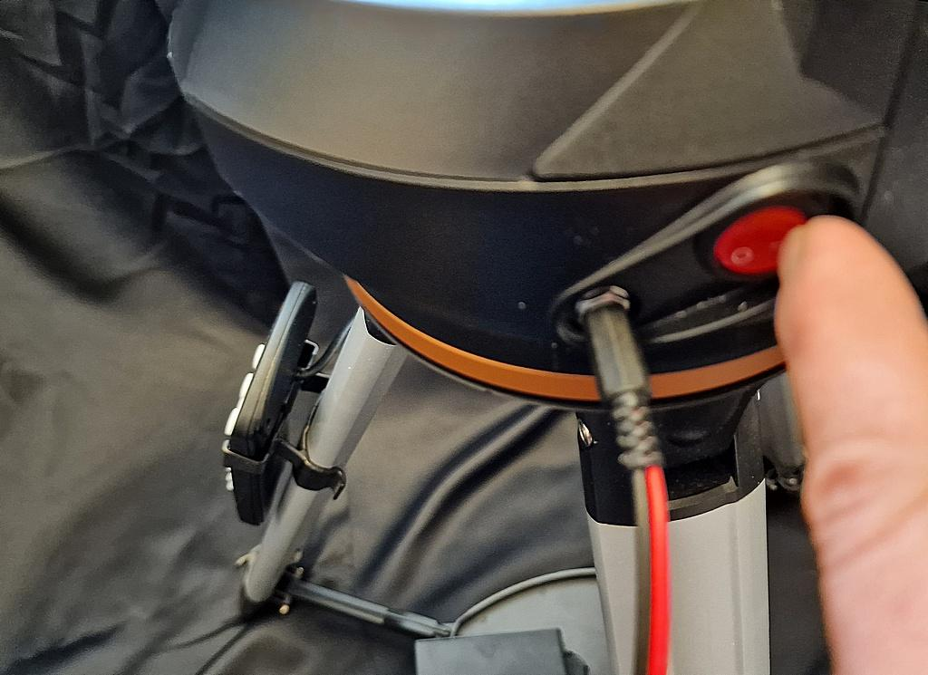
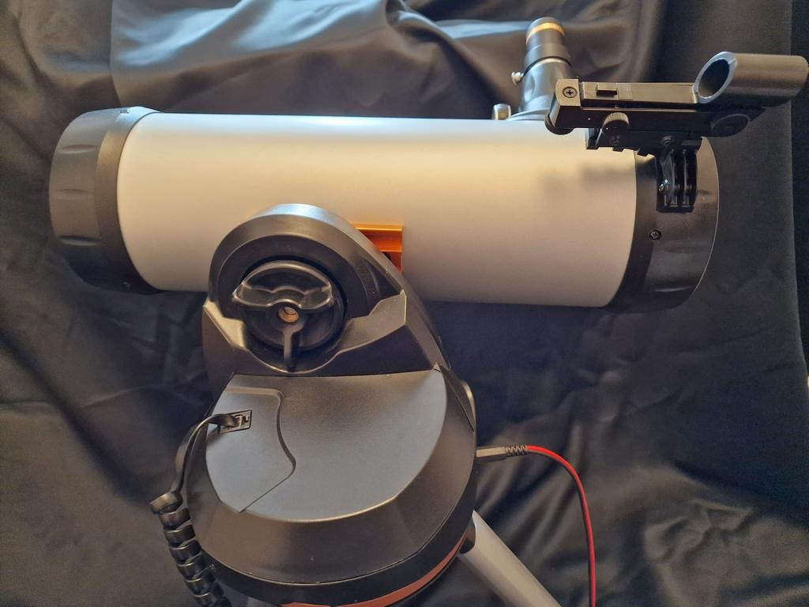
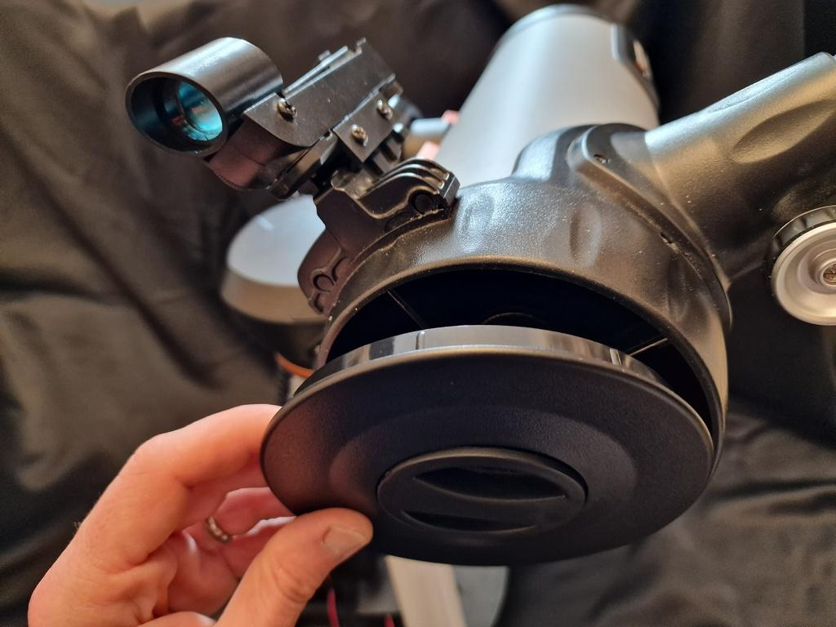
Day time target practice - use the focus wheel and adjust the finderscope. You want to feel confident at aiming and focusing the equipment during the day, before planning an evening event.
Switch on the scope using the red button on the mount.
Use a target away from the sun, such as a chimney or end of a school hall. Ensure that your finderscope and telescope point at the same object. Adjust the finderscope positioning using the dials,
The telescope is ready to use!
Remove the lens cap.
Notes:
Switch on the telescope using the red button on the mount
Remove the telescope lens cap
The telescope is ready to use
The first thing to do is to switch on the red dot finder and ensure it points to the same thing as the main telescope. Tighten the Up/Down clutch on the mount and use the hand controller to point the main telescope at a distant object.Use the red dot finder adjustments to centre the dot on the same distant object.

Slide 11
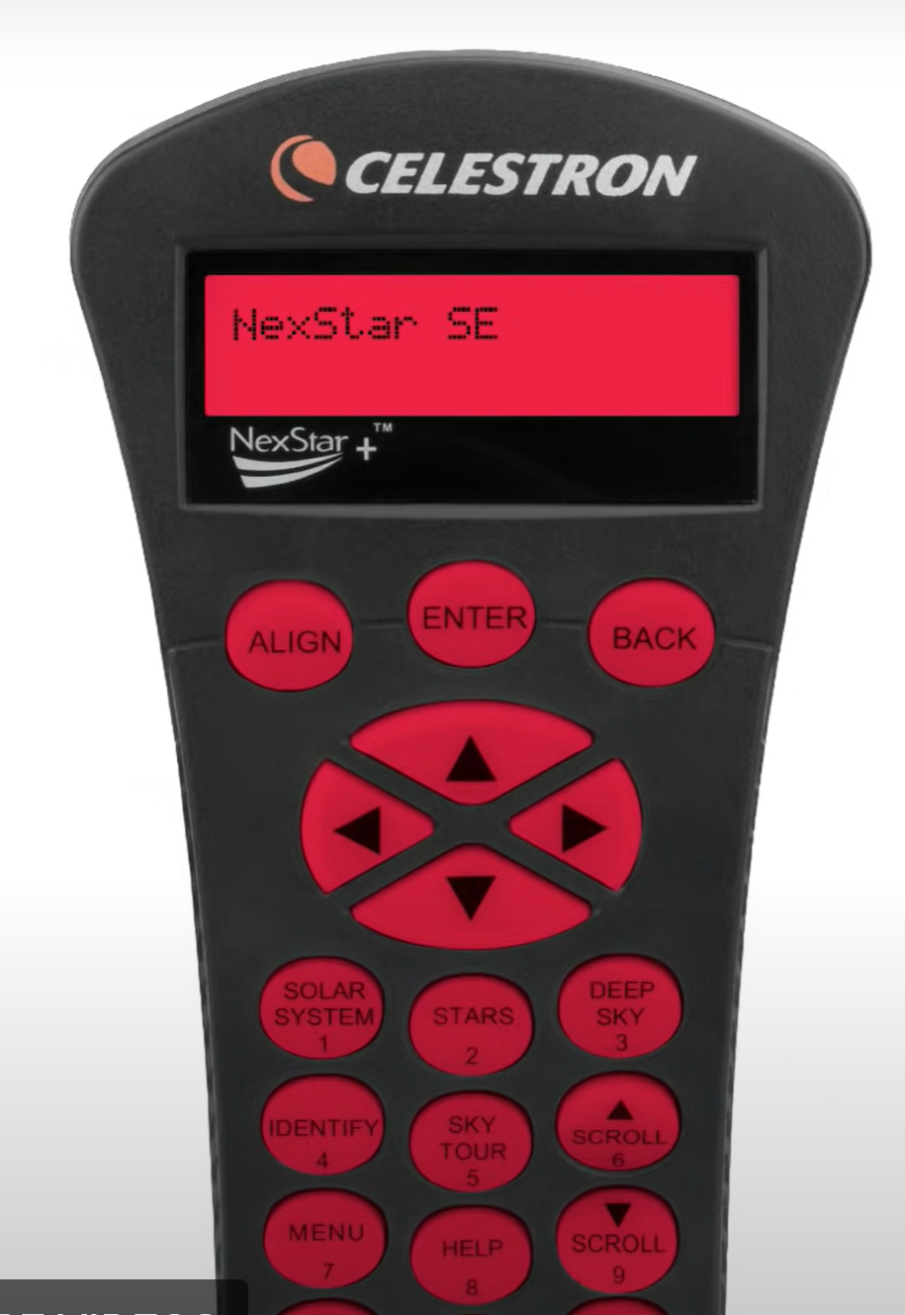
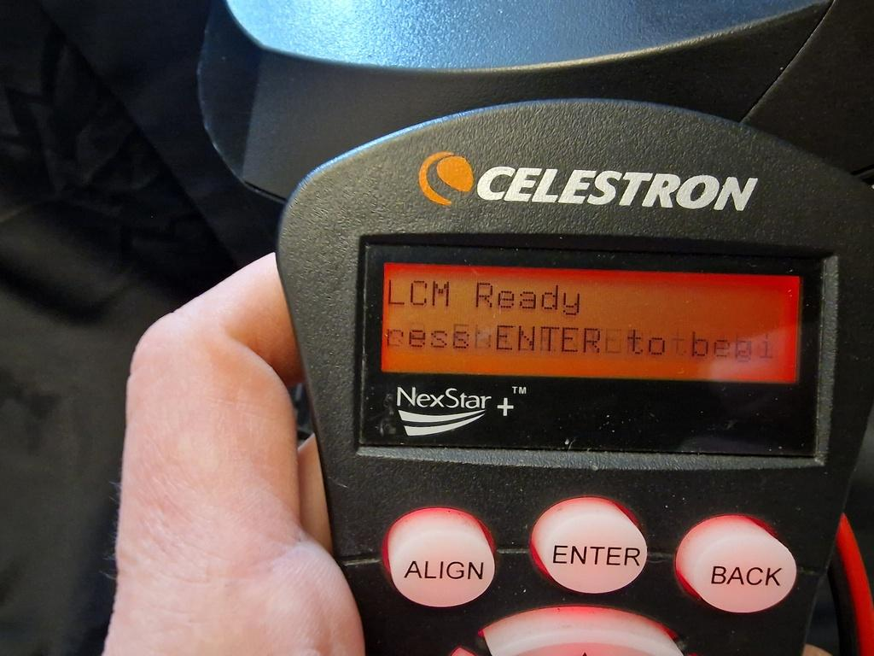
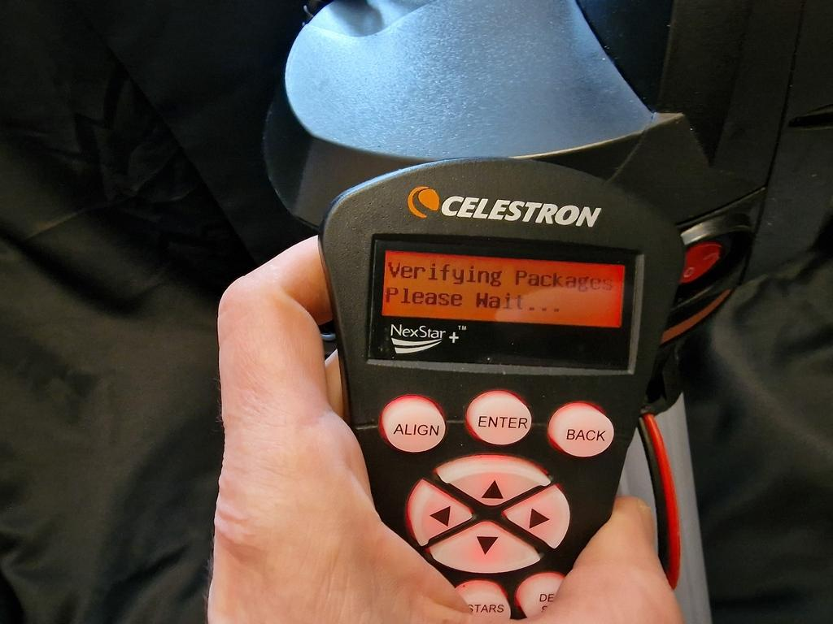
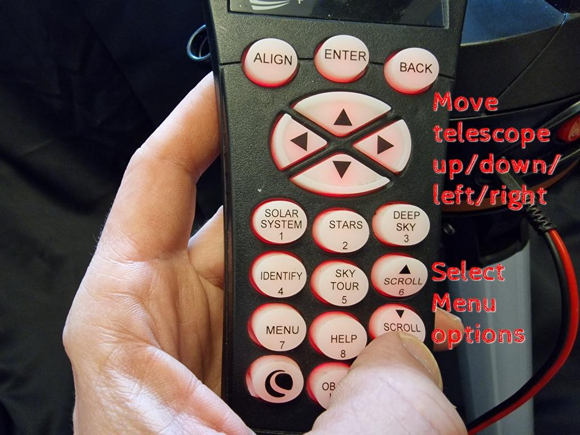
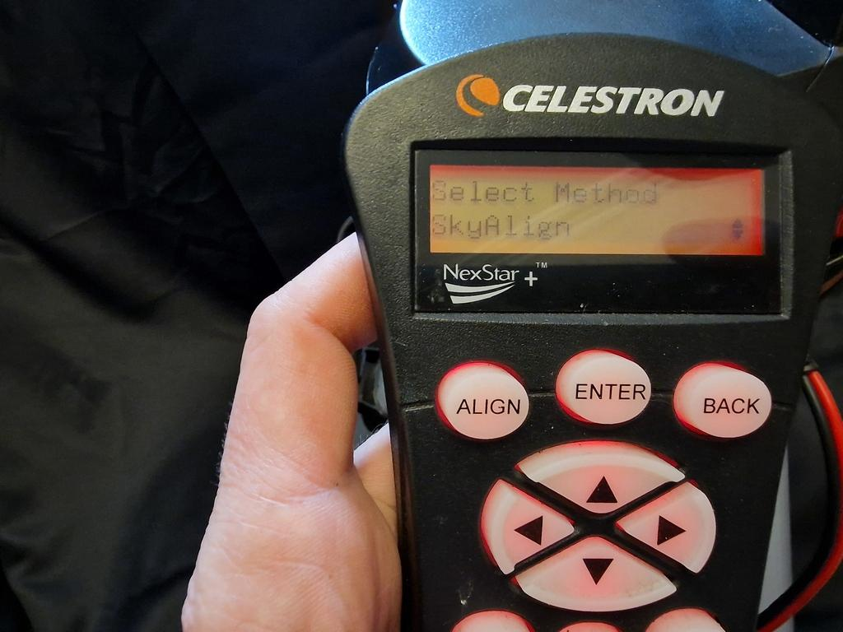
Using the controller - day and night.
When the scope switches on, you’ll see the controller flash and perform checks.
For aligning at night, switch on then press Enter to continue the setup.
You can now use Solar System, Stars, Deep Sky and Sky Tour buttons and the scope will move for you.
Use the scroll buttons to select different suggested targets.
The display will show the name of targets.
The telescope will also move on its own, tracking the night sky as it ‘moves’ due to the Earth’s rotation.
Press Enter to select SkyAlign, and add date and time before finding three bright stars in the sky (pressing Enter and Align after each).
You can use the hand controller to move the telescope as soon as the power is on (before completing SkyAlign)

Slide 12
Safety Warning
NEVER look at the sun through a lens without a front mounted solar filter.
The loan box does not include a solar filter.
Teachers: Please take steps to assess the risk and mitigate the chances a pupil may try to look at the sun through the telescope.
Consider: Positioning, supervision ratios, supervision of the telescope.
Do not leave pupils unattended with a telescope.

Slide 13
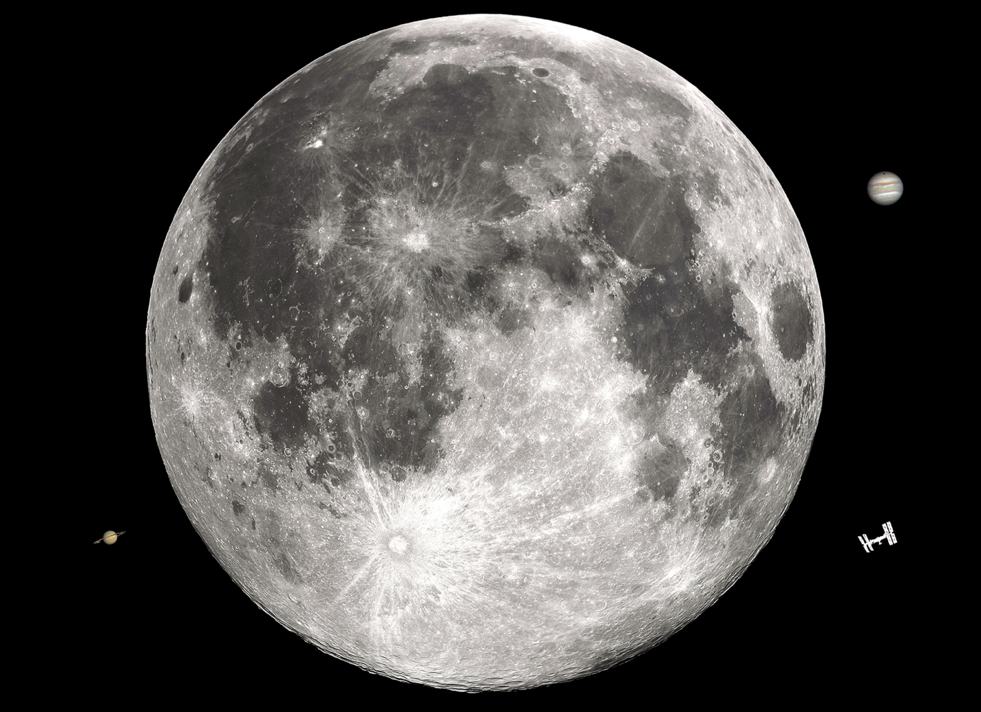
Practise finding a target in the day.
This 20 meter target sheet shows the moon, the ISS, Jupiter and Saturn as you would see them at night through this telescope - when printed on A4 paper, the size corresponds well to the lens of our telescope.
Place the target 20 meters away from your telescope in a school hall or playground. Take time practising how to ‘find the target’ indoors in daylight!
Practise until you get the hang of handling the telescope, you will find it much easier than in the dark.

Slide 14
Review
01
03
Safety first
Super sights
02
04
Telescope type
Simple sizes
What is the most important safety fact with telescopes?
Can you describe the features of the finderscope?
What kind of telescope do you have, refractor (lenses only) or reflector (mirrors and lenses)?
Are you very likely to see distant galaxies and nebulae as a beginner with a new telescope?
Notes:
Answers:
Never look at the Sun through a lens or telescope without a front mounted solar filter or Herschel Wedge
The Bath Astronomers loan telescope is a reflecting telescope, it has two mirrors and eyepiece lenses
The finderscope is like a mini refractor telescope to help you find a target, but the image is always flipped ‘upside down’ and left right on all scopes.
Not really, pictures of colourful galaxies and nebulae are often produced by many astro-photographs layered on top of each other with special colour filters and settings to make the very small amount of light collected richer and more vibrant against the black of space. A beginner with a new telescope will need a bit of practise before they can find, record and process such distant and detailed images.

Slide 15
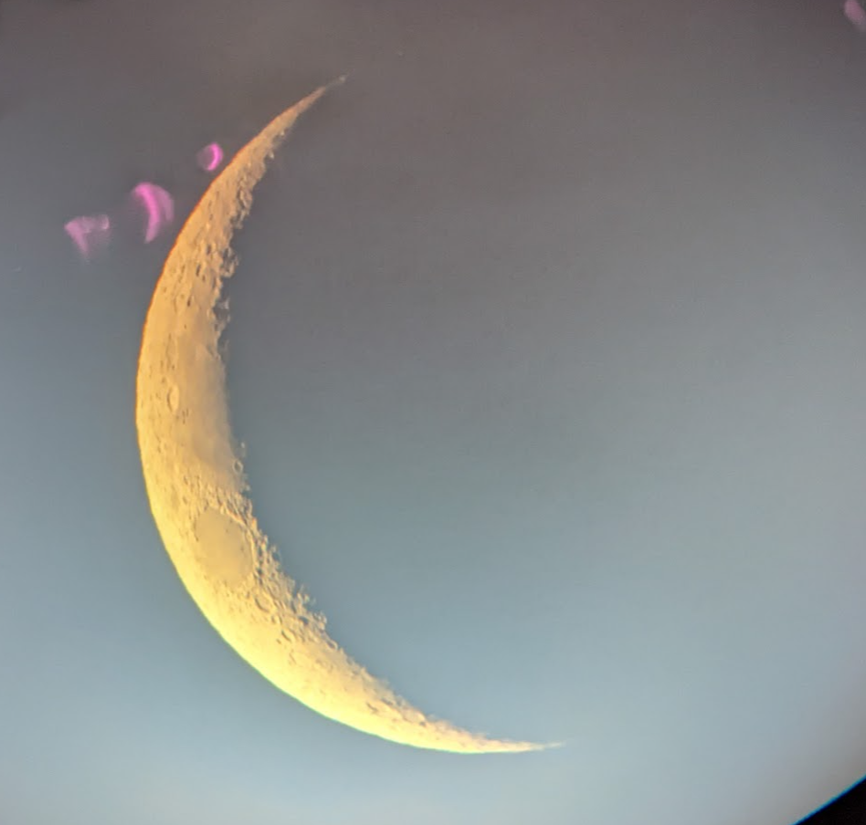
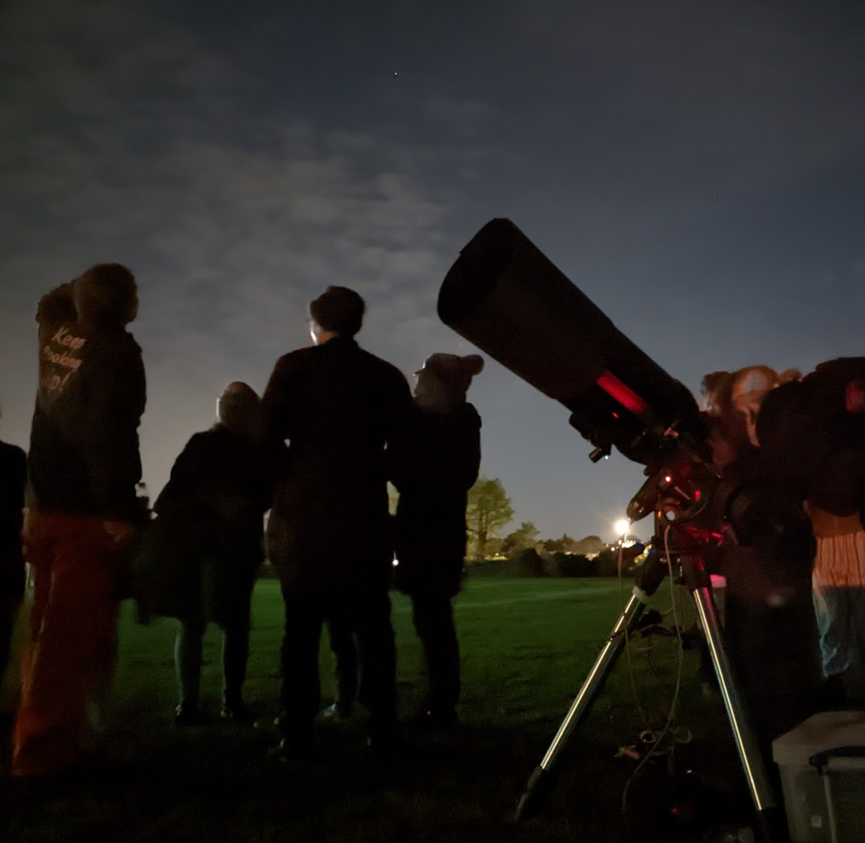
Next steps: Plan a twilight observation
01
02
03
We recommend learning about reading skymaps and planning observations via our two previous lessons, 1: Navigating the Night Sky and 2: Using Binoculars
Open Stellarium and your school calendar.
Use Stellarium’s time and date tools to look into the future skies!
Find a suitable date in Autumn or Spring where the moon is visible in the sky between 3pm and 7pm, and choose a suitable time and date to host an observation event at your school.
The easiest target is the moon, ideally avoiding a full moon (so bright!) or a new moon (too dark!). A moon that’s not quite full or new will have a lovely line of light and shadow cast over it’s rocky surface and craters - perfect to view through a telescope!
You might even get lucky as Venus is often found just after sunset and Jupiter appears as a big ‘star’ to the eye - see if you can target the telescope at it.

Slide 16
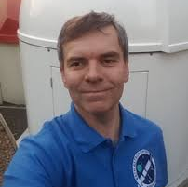
Get in Touch!
If you would like further information, activity ideas or just to ask questions, please feel free to get in touch!
Simon Holbeche Chairperson
Bath Astronomers
Camilla Evans Lead STEM Educator
Wishford Schools
Get in touch with your nearest Astronomy group, they will be very welcoming to questions and may run public observation evenings you can join. Some may even loan equipment such as binoculars or telescopes. Go Stargazing has a great directory of groups across the UK here.
Presentation design credit: Slidesgo

Slide 17
Lesson plan - please copy and paste as required!
LO: To be able to find a target in the night sky using a telescope. |  |  | MTP: This lesson’s placement is recommended as lesson 6 of 6. View MTP.
NC objectives | Introduction | Differentiation - support | Main Activities | Differentiation - extension | Plenary
KS3 Space Physics the transmission of light through materials: absorption, diffuse scattering and specular reflection at a surface KS2 Science Earth and Space Use the earth’s rotation to explain… the movement of the sun across the sky (movement of stars) | Slide 4: Explore what pupils understand a telescope to be - clear up confusion with a microscope, but look at the similarities and differences. Pupils may prefer to relate them to glasses or magnifying glasses. Slide 5: A brief history - draw attention to the fact that modern telescopes can’t be attributed to one sole inventor. | Pupils with glasses can still wear them when using telescopes. Encourage pupils not to lean on the scope - it will lose its target! Use a sturdy box for shorter or very young pupils to stand on - have an adult on hand to avoid them falling. Have young pupils practise placing their eye on the eyepiece by asking them to place their palm on one eye with the other shut. As they pull away their palm gently, can they focus their eye on the fine lines of their palm? This may help them ‘feel’ what it is like to look into a lens very closely. Very young pupils may need to hold their other eye shut! | Slide 6: Try to label with post-it notes, or identify verbally, the key parts common to many reflector telescopes. Aperture, finderscope, mount, focuser, optical tube, eyepiece Slide 7-11: Take time to assemble the loan telescope in front of the pupils. If you have practised beforehand, you can even make a guessing game of what goes where with the pupils. Discuss safe handling, not touching the aperture or eyepieces if possible, using the finderscope to target the optical tube. If the eyepiece gets dirty, avoid using cleaning fluids - Bath Astronomers can clean it on return if you let us know it needs it. Slide 12: Review safety - consult with pupils the key info, no looking at the sun, don’t leave the scope unattended with children. Slide 9: Read before trying in school hall or the playground, use the 20 meter target sheet printed on A4 and have pupils practise using the finderscope, then the focuser, to view the sheet. | Can pupils identify what else has an aperture? (Cameras, binoculars) Does aperture width matter, if so, how? Think of large stationary telescopes. Larger apertures let in more light. Might the atmosphere cause problems? (Blurring, wobbles) How could we avoid them? (Use a space based telescope such as Hubble or Webb) | Slide 14 - Review: Ask pupils questions on safety, structure and use of a telescope. Slide 15: Put your learning to use by planning a late afternoon/early evening observation session. Stellarium.org has time and date tools so that you can see what will be in the sky in the future, allowing you to plan an observation of recommended targets such as the moon, Venus or Jupiter. Autumn to Spring provides early evenings perfect for viewing.
This lesson was created by volunteers at Bath Astronomers, a group of amateur astronomers sharing a passion for observing the sky. Please continue to support our free space education for all by giving credit where work is shared, visiting our social media sites or even becoming a member of our group.

